Slide 1

APEX INSTITUTE OF TECHNOLOGY
DEPARTMENT OF COMPUTER SCIENCE & ENGINEERING
Statistics for Data Science(14CSHB-233)
Faculty: Prof. (Dr.) Madan Lal Saini(E13485)
Lecture – 3
Standard Deviation
DISCOVER . LEARN . EMPOWER

Slide 2
Statistics for Data Science : Course Objectives
COURSE OBJECTIVES
The Course aims to:
To equip students with the skills to summarize and interpret data using descriptive statistics and visualization techniques.
To develop a foundational understanding of probability and its applications in data science.
To enable students to perform hypothesis testing and construct confidence intervals for statistical inference.
To teach students how to build and assess linear and logistic regression models for predictive analysis.
To provide hands-on experience with statistical software for data manipulation, analysis, and visualization.

Slide 3
COURSE OUTCOMES
On completion of this course, the students shall be able to:-
CO1 | Summarize and describe the main features of a dataset using measures such as mean, median, mode, variance, and standard deviation, as well as graphical representations like histograms, box plots, and scatter plots.
CO2 | Understand of probability theory, including concepts such as random variables, probability distributions, and the law of large numbers, enabling them to model and reason about uncertainty in data.
CO3 | Apply/perform statistical inference, including hypothesis testing, confidence interval estimation, and p-value computation, to draw valid conclusions from sample data about larger populations.
CO4 | Apply linear and logistic regression techniques to identify relationships between variables, make predictions, and evaluate model performance.
CO5 | Utilize statistical software tools to perform data analysis, including data cleaning, transformation, visualization, and implementing various statistical methods.

Slide 4
Unit-1 Syllabus
Unit-1 | Descriptive Statistics
Descriptive Statistics and Bayes Theorem | Descriptive statistics basics Mean, median, and mode Standard deviation Use of the central tendency measures Bayes Theorem
Data Visualization | Types of visualization Calculation and interpretation of graphs, plot, and measures

Slide 5
SUGGESTIVE READINGS
TEXT BOOKS:
T1. Hastie, Trevor, et al., The elements of statistical learning. Vol. 2. No. 1. New York: Publisher: Springer, Edition: Second Edition (2009), ISBN: 978-0387848570
T2. Montgomery, Douglas C., and George C. Runger. Applied statistics and probability for engineers. John Wiley & Sons, 2010.
T3. Probability and Statistics The Science of Uncertainty Second Ed., Michael J. Evans and Jeffrey S. Rosenthal.
REFERENCE BOOKS:
R1. Practical Statistics for Data Scientists: 50 Essential Concepts, Authors: Peter Bruce, et al, Publisher: O'Reilly Media, Edition: Second Edition (2020), ISBN: 978-1492072942
R2. An Introduction to Statistical Learning: with Applications in R, Authors: Gareth James, et al, Publisher: Springer, Edition: Second Edition (2021), ISBN: 978-1071614174
R3. Think Stats: Exploratory Data Analysis in Python, Author: Allen B. Downey, Publisher: O'Reilly Media, Publication Year: 2014 (2nd Edition), ISBN: 978-1491907337

Slide 6
Descriptive Statistics
Statistics used to describe and interpret
sample data.
Results are not really meant to apply to other
samples or to the larger population
Frequency Distribution
Central Tendency (Mean, Median, Mode)
Percentile Values

Slide 7
Inferential Statistics
Statistics used to make inference about the population from which the sample was drawn.
Correlation
T-test
ANOVA (Analysis of Variance)
Regression

Slide 8
Population vs. Sample
Population: A large group of people to which we are interested in generalizing.
‘parameter’
Sample: A smaller group drawn from a population.
‘statistic’

Slide 9
Measures of Central Tendency
Statistics that identify where the center or middle of the set of scores are.
Mode : Most frequently occurring scores.
Median : the 50th percentile, the second quartile
Mean : Arithmetic means, average, Add all the scores and divide by the number of scores.

Slide 10
Which central tendency to use?
Depends on :
The level of measurement of the data.
2. The shape of the score distribution. (Skewness)

Slide 11
Level of Measurement
Nominal: Categorical scale
e.g. Male/Female, Blue eye/Brown eye/Green eye
Ordinal: Ranking scale
(Differences between the ranks need not be equal)
e.g. Scored highest (100 pts), middle (85 pts), lowest (20 pts)
Interval: The distance between any two adjacent units of measurement (intervals) is the same but there is no meaningful zero point.
e.g. Fahrenheit temperature
Ratio: The distance between any two adjacent units of measurement is the same and there is a true zero point.
e.g. Height measurement, Weight measurement

Slide 12
Which central tendency to use?
The level of measurement of the data.
Mode---Nominal, Ordinal, Interval or Ratio
Median--- Ordinal, Interval, or Ratio
Mean---Interval or Ratio

Slide 13
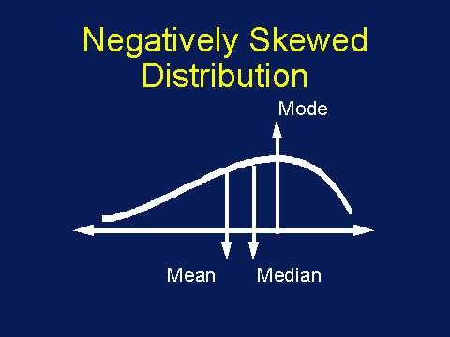
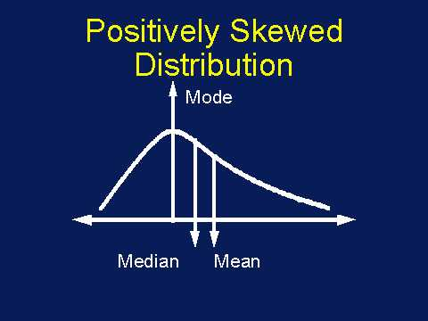
Shape of the distribution: Skewness
A measure of the lack of symmetry, or the lopsidedness of a distribution. (> or < 2)
Use “median”

Slide 14
Shape of Distribution: Kurtosis
How flat or peaked a distribution appears.
(Does not affect the central tendency)
Leptokurtic
Mesokurtic
(Normal Distribution)
Platykurtic

Slide 15
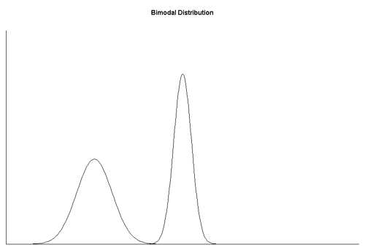
Shape of the distribution: unimodal, bimodal
Bimodal --- 2 Modes
Mode is not a good indicator of the central tendency.

Slide 16
Which central tendency to use?
Symmetric, unimodal, Normal distribution ---Mode, Median, Mean all the same.
Skewed --- use the Median.
Bimodal --- do not use the Mode.

Slide 17
Describing data using Tables and Charts
Frequency table
Stem and leaf
Polygon
Histogram
Box and whisker

Slide 18
Measures of Variability
Reflects how scores differ from one another. - spread - dispersion
Example:
7, 6, 3, 3, 1
3, 4, 4, 5, 4,
4, 4, 4, 4, 4,

Slide 19
Measures of Variability
Range
Highest score – lowest score
Example:
7, 6, 3, 3, 1 ---- range = 6
3, 4, 4, 5, 4 ---- range = 2
4, 4, 4, 4, 4 ---- range = 0
Variance
Standard Deviation

Slide 20
Measures of Variability
Range
Standard Deviation
Variance

Slide 21
Standard Deviation
Standard Deviation: A measure of the spread of the scores around the mean.
Average distance from the mean.
Example:Can you calculate the average distance of each score from the mean? (X=4)
7, 6, 3, 3, 1 (distance from the mean: 3,2,-1,-1,-3)
3, 4, 4, 5, 4, (distance from the mean: -1,0,0,1,0)
You can’t calculate the mean because the sum of the ditance from the mean is always 0.

Slide 22
Formula for Standard Deviation
s = Σ(X-X)²
n-1
Sigma: sum of what follows
Each individual score
Mean of all the scores
Sample size
Standard deviation
of the sample

Slide 23
Why n-1?
s (lower case sigma) is an estimate of the population standard deviation (σ :sigma) .
In order to calculate an unbiased estimate of the population standard deviation, subtract one from the denominator.
Sample standard deviation tends to be an underestimation of the population standard deviation.

Slide 24
Variance
Variance: Standard deviation squared.
S = Σ(X-X)²
n-1
Not likely to see the variance mentioned by itself in a report.
Difficult to interpret.
But it is important since it is used in many statistical formulas and techniques.

Slide 25
Questions?
What is the purpose of descriptive statistics?
Define the term "mean" in the context of descriptive statistics.
How is the median of a dataset calculated?
What does the mode of a dataset represent?
Explain the concept of "range" in descriptive statistics.
What is a "standard deviation" and what does it indicate about a dataset?
How is variance related to standard deviation?
Describe what a histogram is used for in descriptive statistics.
What is a "box plot" and what information does it convey?
Explain the difference between a population and a sample in statistics.

Slide 26
References
Books:
Hastie, Trevor, et al., The elements of statistical learning. Vol. 2. No. 1. New York: Publisher: Springer, Edition: Second Edition (2009), ISBN: 978-0387848570
Practical Statistics for Data Scientists: 50 Essential Concepts, Authors: Peter Bruce, et al, Publisher: O'Reilly Media, Edition: Second Edition (2020), ISBN: 978-1492072942
Research Papers:
Carmichael, Iain, and J. S. Marron. "Data science vs. statistics: two cultures?." Japanese Journal of Statistics and Data Science 1.1 (2018): 117-138.
Hardin, Johanna, et al. "Data science in statistics curricula: Preparing students to “think with data”." The American Statistician 69.4 (2015): 343-353.
Websites:
https://365datascience.com/resources-center/course-notes/statistics/
https://www.geeksforgeeks.org/7-basic-statistics-concepts-for-data-science/
Videos:
https://www.youtube.com/playlist?list=PLZ2ps__7DhBYrMs3zybOqr1DzMFCX49xG

Slide 27
THANK YOU
For queries
Email: madan.e13485@cumail.in

